Slide 1
EMAN410 Seminar, 3 August 2012, Physics Department, University of Otago, Dunedin, New Zealand/ Aotearoa Scenarios and Policies for 100% Renewable Electricity in New Zealand and Australia
Mark Diesendorf
University of New South Wales
Sydney, Australia
Email : m.diesendorf@unsw.edu.au

Slide 2
Plan of Lecture
Motivation, context
NZ 100% renewable electricity scenario
Australia 100% renewable electricity scenario
Policies need to drive the transition

Slide 3
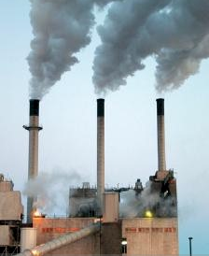
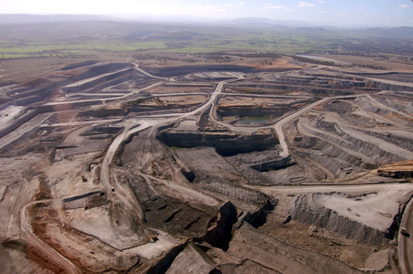
Why change our Energy System?
Mitigation of global climate change resulting primarily from burning fossil fuels
Gain energy security: peak in global oil production is here; Australia peaked in 2000
After initial investment, cap energy prices
Avoid land degradation and air & water pollution from fossil fuels
Create new local jobs in cleaner industries

Slide 4
But there are opponents…

Slide 5
Context: Why focus on electricity?
Biggest single source of GHG emissions globally and in Australia, but not in New Zealand
Renewable electricity can contribute to current non-electrical energy use: heat and urban transport
Technological change could probably be implemented faster for electricity generation than transport or heat

Slide 6
Electricity Generation in New Zealand
In 2011 electricity generation of 43 TWh was 23% fossil fuelled
Hydro 58%, but only 34 days of storage at peak winter demand.
Less hydro and more fossil fuels used during drought periods.

Slide 7
Electricity Generation in New Zealand Mason, Page & Williamson (2010), University of Canterbury
Typical 10-day historic period, fossil + existing RE, ½ hour data

Slide 8
Simulations of 100% RE for New Zealand Mason, Page & Williamson (2010)
RE technology | Historic annual energy generation 2011 (%) | Annual energy generation, 100% RE, max. wind, Scenario 6 (%) | Data
Hydro | 58 | 40 | Daily
Wind | 5 | 36 | ½ hour
Geothermal | 13 | 24 | n/a, constant
Biomass | < 1 | <1 | n/a; peakload
Demand | Observed 2005-2007 | Observed 2005-2007 | ½ hour
Method: Hydro scheduled to fill the troughs in wind.
Little geographic diversity assumed for wind

Slide 9
Results for New Zealand Simulations
100% RE (hydro, wind and geothermal) is technically feasible
To maintain reliability, either additional peakload plant (biofuelled) or demand reduction is needed.
Some spillage of wind energy is inevitable during periods of high wind and low demand
NZ potential for pumped hydro storage needs more research

Slide 10
How can Renewable Energy replace Fossil Fuels in Australia?
Energy end-use Current fossil source | Comment; Renewable energy substitute
Electricity mostly coal | Electricity generation --> 35% of Australia’s GHG emissions. 100% renewables possible before 2040.
Transport mostly oil | 14% of GHG emissions. Electric vehicles for urban transport; inter-city high-speed rail; biofuels for rural vehicles.
Heat (non-electrical) mostly gas | About 17% of GHG emissions Low temperature heat from solar; some high temperature heat from renewable electricity & possibly biofuels.

Slide 11
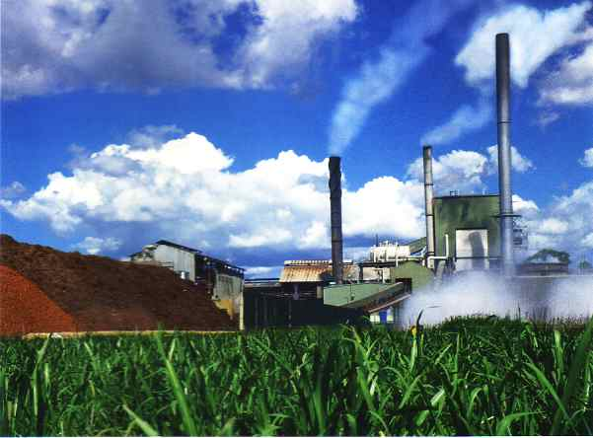
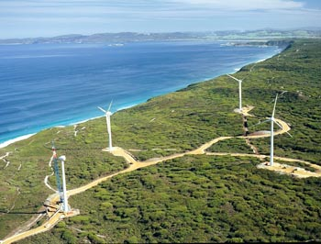
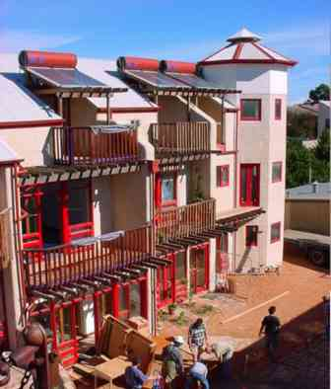
Bioenergy, Rocky Point, Qld
Wind, Albany, WA
Concentrated solar
Energy efficiency
Sustainable Energy Future Mix
Solar-efficient homes, Christie Walk, Adelaide
PV solar tiles, Sydney

Slide 12
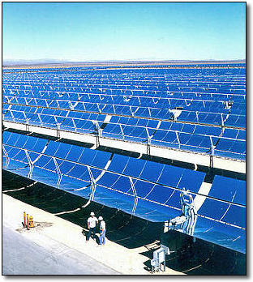
Concentrated Solar Thermal Electricity (CST)
Revival post-2004 in Spain and USA
A mix of technologies at demonstration and limited mass production stages
Globally 1000 MW operating; 1000 MW under construction; 8000 MW advanced planning; in Oz only pilot plants so far
Low-cost thermal storage in molten salts or possibly concrete, graphite, ammonia
With storage can generate 24-hour power, provided…
354 MW trough system in California: Generation I is bankable
Notes:
More R, D and D funding is needed for these two technologies.

Slide 13
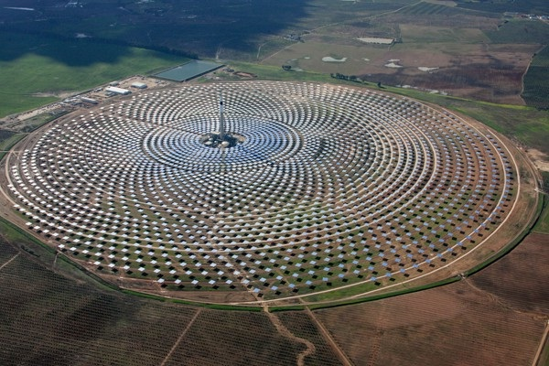
Gemasolar Power Tower with 15-Hour Storage in Molten Salt, Spain
Higher temperature >500°C than troughs
Hence more efficient
Rated power 20 MW
15 hr thermal storage
Capacity factor 63%
Demonstration plant; not yet bankable

Slide 14
Australian Electricity Generation by Fuel, 2008-09 Source: ABARE (2011)
Total 261 TWh, including a little off-grid.
Since 2008-09, wind → 2%; solar → 1%; demand growth ceased

Slide 15
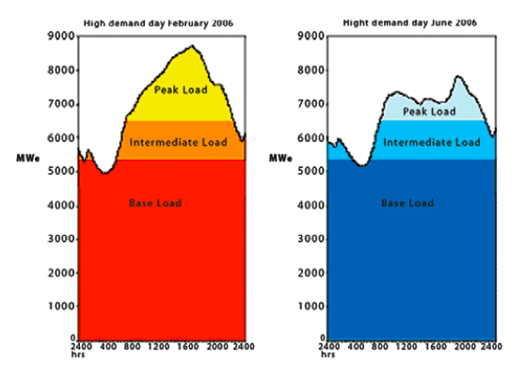
Daily Demand/Load Curves: Summer & Winter Victoria, Australia
15

Slide 16
Properties of Conventional Power Stations in Systems with Fossil or nuclear Baseload
Type | Fuels | Capital cost (annualised) | Operating cost (mostly fuel) | Ability to ramp | Capacity factor
Base | Coal; nuclear | High | Low | Low | High
Intermediate | Gas | Medium | Medium | Medium | Medium
Peak | Hydro, gas turbine | Low for gas turbine | High | High | Low
Capacity factor ₌ average power x 100 ₌ energy generated over period x 100
rated power energy if operated always at rated power
where average is usually calculated over a year or over the lifetime of the station. Rated power or capacity is maximum design power output in megawatts.
Don’t confuse capacity factor with efficiency! A peak-load station may have a capacity factor of 5-10%, but it is not necessarily inefficient in terms of energy conversion.

Slide 17
Optimal Mix of Base- & Peak-Load
Too much base-load makes capital cost too high.
Too much peak-load makes fuel cost too high
Optimal mix of base-load and peak-load gives minimum annual cost.
Installing a lot of wind shifts optimal mix towards less base-load and more peak-load. So wind can replace coal.
Type | Fuels | Capital cost (annualised) | Operating cost (mostly fuel) | Ability to ramp | Capacity factor
Base | Coal; nuclear | High | Low | Low | High
Intermediate | Gas | Medium | Medium | Medium | Medium
Peak | Hydro, gas turbine | Low for gas turbine | High | High | Low

Slide 18
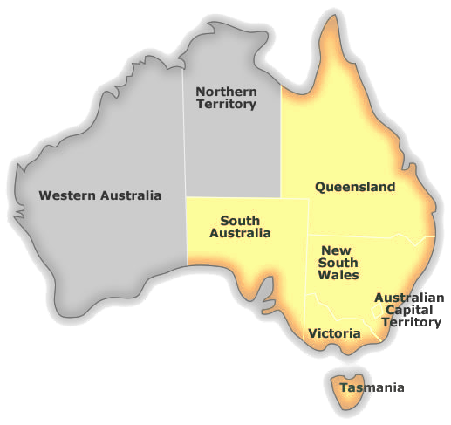
Simulations of 100% RE in the Australian National Electricity Market (NEM)
Ben Elliston, Mark Diesendorf & Iain MacGill:
Q: Could the NEM have operated in 2010 using 100% renewable generation based on commercially available technologies?
A: Test by hourly computer simulation with real data on demand, wind & sun.

Slide 19
Data Sources
Quantity | Source
Demand | AEMO: 30 min.data aggregated across NEM region and converted to hourly
Wind (existing wind farms in S-E) | AEMO: 5-min. data converted to hourly
Wind (hypothetical wind farms in N-E) | CSIRO: Air Pollution Model (TAPAM)
Solar | BoM: hourly satellite data for GHI & DNI
Other weather | BoM: temperature, humidity, etc.
Wind, solar and other weather data inputted to NREL’s System Advisor Model (SAM) to obtain CST and PV outputs in selected locations

Slide 20
Simulation Method
Simulation computer program written by Ben Elliston in Python programming language. It has 3 components:
Framework supervising simulation; independent of the energy system
Integrated database of meteorology and electricity industry data
Library of simulated power generators
‘Copper plate’ assumption
Power can flow unconstrained from any generation site to any load site. Hence, demand across all NEM regions is aggregated, as is supply.
Baseline renewable energy supply mix chosen by guided trial and error exploration

Slide 21
Baseline Renewable Energy Generation Mix in Order of Dispatch
Technology | Installed capacity (GW) | % of annual energy demand (approx.)
Wind, capacity factor 30% | 23.2 | 30
PV, flat-plate, rooftop, capacity factor ~16% | 14.6 | 10
CST with thermal storage, solar multiple 2.5, storage 15 hr, capacity factor ~60% | 15.6 | 40
Pumped hydro (existing) | 2.2
Hydro without pumped storage (existing) | 4.9 | 6
Gas turbines, biofuelled | 24 | 14

Slide 22
Baseline NEM Simulation 2010 Summary of Results
Annual electrical energy demand (TWh) | 204.4 | NEM excludes Western Aust.
Spilled electricity (TWh) | 10.2
Spilled hours | 1606
Unserved energy (%) | 0.002 | equals NEM reliability standard
Unmet hours | 6 | All in winter
Electrical energy from gas turbines (TWh) | 28 | 14% of demand
Largest supply shortfall (GW) | 1.33 | 4% of max. demand
Maximum demand 2010 (GW) | 33.6

Slide 23
Supply and Demand for a Typical Week in Summer 2010 – Baseline Simulation
CST behaves like a fluctuating baseload power station in summer. Negligible GT energy used.

Slide 24
Supply and Demand for a Challenging Week in Winter 2010 – Baseline Simulation
CST does NOT behave like fluctuating baseload power station in winter. Much GT energy used.

Slide 25
Effect of Increasing CST Capacity with fixed solar multiple and storage
Reduces gas turbine (GT) energy gradually and reduces unmet hours from 6 to 2.
But increases spilled hours & spilled energy and has high cost.

Slide 26
Effect of Increasing Solar Multiple
Reduces GT energy substantially – but at high cost.

Slide 27
Reducing Demand Peaks increases Reliability
5% reduction in the 6 winter demand peaks, that produce unmet hours in baseline simulation, eliminates all unmet hours and unmet power.

Slide 28
Reducing Demand Peaks Reduces Required GT Capacity when Reliability is Fixed
By reducing GT generating capacity from 21 GW to 15 GW, the NEM reliability standard can be met if demand during the unmet hours is reduced by 19%. GT energy shrinks by 4%.

Slide 29
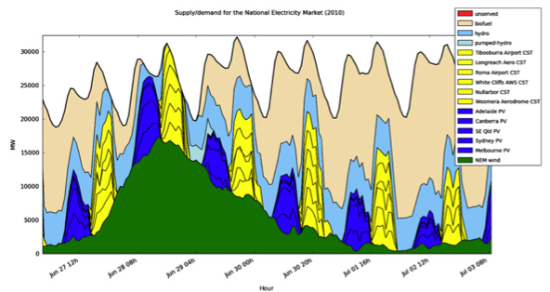
Effect of Time Delay in CST Winter Dispatch More Solar Input goes into the Thermal Store
No time delay
Time delay 7h reduces GT energy (and capacity)

Slide 30
Effect of Time Delay in CST Winter Dispatch More Solar Input goes into the Thermal Store
5-hr dispatch delay gives quite large reduction in GT energy use and capacity.

Slide 31
Effect of Greater Wind Diversity on Bioenergy Generation in Gas Turbines

Slide 32
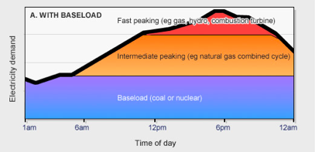
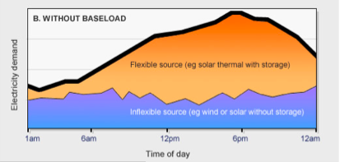
Meeting Demand without Baseload Stations
Old concept:
With baseload power stations
Source of diagrams: David Mills
New concept:
No baseload power stations
Flexible
or biofuelled gas turbine or hydro
Inflexible

Slide 33
Meeting Demand without Baseload Stations
RE supplied by mix of inflexible plants (eg, wind and PV without storage) and flexible plants (eg, CST with thermal storage, hydro with storage, biofuelled gas turbines)
Flexible plants handle the fluctuations in power output from inflexible plants
Demand management in a ‘smart grid’ can also play an important, low-cost role.
The key parameter is reliability of the whole supply-demand system, not reliability of individual technologies

Slide 34
Future Simulation Research Required
Do economics of various RE mixes compared with various conventional mixes (gas, nuclear, coal with CCS). (Work in progress)
Remove ‘copperplate’ assumption, treating each State separately together with actual & hypothetical transmission links.
Do economics with separate states and transmission included (Work in progress)
Run multiple years, either from empirical data or by Monte Carlo simulation

Slide 35
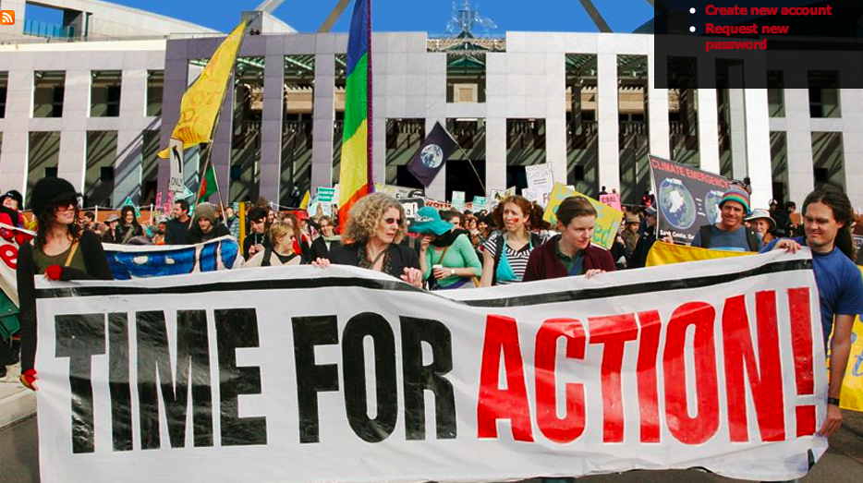
4 Options for Grass-Roots Social Change
Ballot box – necessary but very limited influence in 2-party system
Individual – necessary as an example, showing leadership, but not nearly sufficient
Local community action -- more effective than individual; can help build state/national awareness
Collective action by a social movement – huge potential, essential when ‘democratic governments’ fail to implement the will of the people

Slide 36
Collective Action to Press for Good Government Policy

Slide 37
Policies must be appropriate to each Stage of Technology Development
R&D | Demonstration | Limited mass production | Large-scale mass production
 |  |  | Energy efficiency & conservation; hydro
 | Concentrated solar thermal power with thermal storage (power tower) | Off-shore wind; geothermal heat; solar space heating & cooling | On-shore wind; conventional geothermal
Advanced PV; artificial photosynthesis; advanced batteries; hydrogen fuel cells | Marine; 2nd generation biofuels; floating wind turbines; hot rock geothermal | Concentrated solar thermal power with thermal storage (troughs) | Solar hot water; solar PV; 1st generation biofuels; solid biomass

Slide 38
Policy Options for different Stages of Technological Development
Technology stage | Policy options (examples)
R & D | Grants
Demonstration | Grants; government guaranteed loans
Limited commercial deployment | Feed-in tariffs; targets with tradable certificates; reverse auction
Large-scale commercial deployment | Carbon tax or tradable emission permits; declining feed-in tariffs; targets with tradable certificates

Slide 39
Why a Carbon Price is Necessary
Sends message to investors that making investment in new dirty coal-fired power stations very risky
It’s the only way to exert pressure for change on the whole economy. A carbon price applied to the major greenhouse polluters flows ‘downstream’ to all economic transactions.
Gives message consistent with other policies
If high enough, includes externalities (environmental, health and social costs) in prices of fossil fuels
Raises revenue for a just transition and for infrastructure

Slide 40
Why a Carbon Price is Not Sufficient Market Failures
$23/tonne of CO₂ is too small to change the energy system
Energy efficiency limited by split incentives, high up-front costs, etc.
Market fails to provide infrastructure (eg, transmission lines; railways; gas pipelines)
Consumers who don’t have access to alternatives must pay the price and continue to pollute
Market is short-term, based on marginal economics; inadequate for long-term planning
Market doesn’t handle risk and uncertainty well
None of these market failures is a logical argument against pricing being necessary.

Slide 41
Australian Govt’s Clean Energy Future Package
Carbon tax on major polluters for 3 years commencing 1 July 2012, followed by ETS with $15/tonne floor price for 3 years
Funding to buy out 2000 MW of brown coal power stations
Compensation to low- & medium-income earners by tripling tax-free threshold, higher pensions, family allowances & other benefits. $15B over 4 yrs.
Clean Energy Finance Corporation (new funding of $10B over 5 years from 2013-14) to support investment; Coalition would terminate it
Existing RE programs placed under ARENA with ‘independent’ board
New long-term greenhouse target of 80% reduction below 2000 level by 2050. But no mechanism to achieve it.
New energy efficiency assistance programs for households, industries, small business

Slide 42
Principal Shortcomings of Clean Energy Future Package
Big ‘compensation’, the Energy Security Fund, to the dirtiest electricity generators: free permits & cash worth $5.5B over 6 yrs from 2011-12.
Huge assistance ($9.2B over 3 yrs) to energy-intensive trade-exposed industries labelled as Jobs & Competitiveness Program
50% of permits can be purchased from cheap overseas offsets of dubious effectiveness
Absence of market ‘pull’ instrument, such as feed-in tariffs, to accelerate deployment of large-scale solar power, which has huge resource
Low carbon price => gas-fired likely to be the principal substitute for the few coal-fired power stations that will be retired before 2020
Floor price for the ETS is too low at $15/tonne and limited to 3 years.

Slide 43
Principal Shortcomings of the Plan ctd
Excessive (non-package) support to ‘gassy’ coal-mine owners: $1.3B over 6 yrs. Better to allow these mines to close and pay out each miner $100k.
Cars, LCVs & AFF industries excluded from carbon price, reducing revenue and putting greater costs on electricity users.
Regional structural adjustment assistance ($200M over 7 yrs from 2012-13) apparently limited to assistance in finding another job

Slide 44
Shortcomings of Addressing only Technology
I = PAT
Impact = Population x Affluence x Technology
where Affluence A = Consumption $ /person
Technology T = Impact/Consumption
I = P x (GDP)/P x I/(GDP)
or I = I, an identity
Each of the 3 factors of environmental impact is amenable to separate policies.

Slide 45
Pressure for genuine climate action is needed on Governments by communities, business and unions
UNSW Press 2009

Slide 46
Further Reading
Mason,IG, Page, SC & Williamson AG (2010) ‘A 100% electricity generation system for New Zealand utilising hydro, wind, geothermal and biomass resources, Energy Policy 38: 3973-3984.
Elliston, B., Diesendorf, M. and MacGill, I. (2012) ‘Simulations of scenarios with 100% renewable electricity in the Australian National Electricity Market’, Energy Policy 45:606-613.
WBGU (2011) World in Transition: a Social Contract for Sustainability. Berlin: WBGU (German Advisory Council on Global Change).

