Slide 1
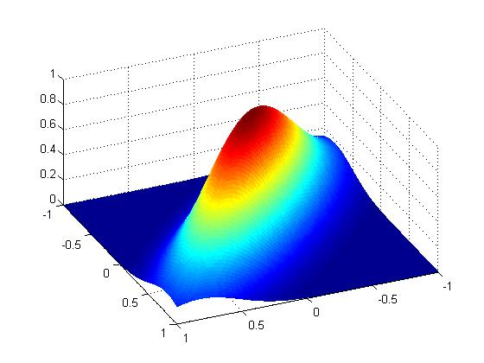
Some implementation issues with iterative Gaussian samplers in finite precision
Al Parker and Colin Fox
SUQ13
January 7, 2013

Slide 2
Outline
Iterative linear solvers and Gaussian samplers …
  Convergence theory is the same
  Same reduction in error per iteration
A sampler stopping criterion
How many sampler iterations to convergence?
Samplers equivalent in infinite precision perform differently in finite precision.
State of the art: CG-Chebyshev-SSOR Gaussian sampler
In finite precision, convergence to N(0, A⁻¹) implies convergence to N(0,A). The converse is not true.
Some future work

Slide 3
The multivariate Gaussian distribution

Slide 4
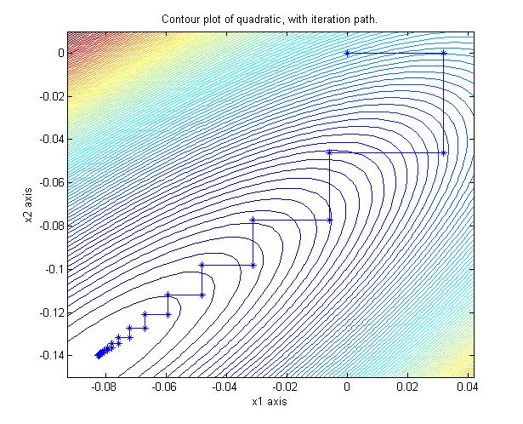
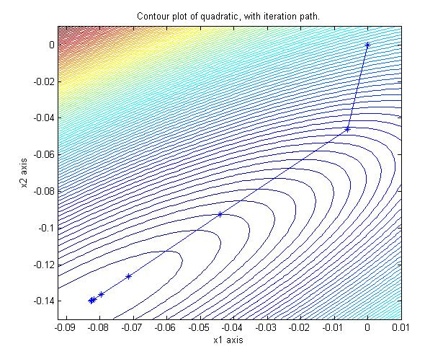
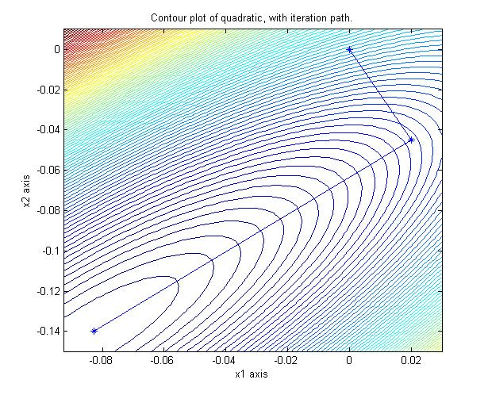
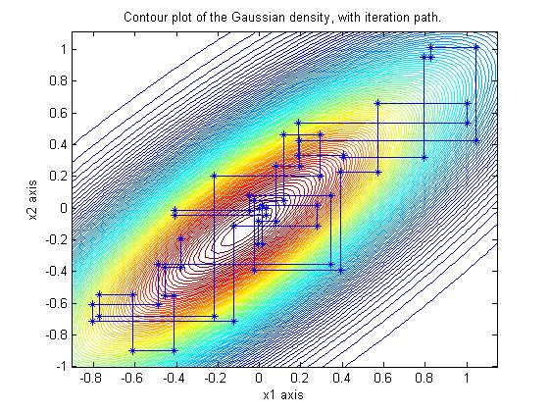
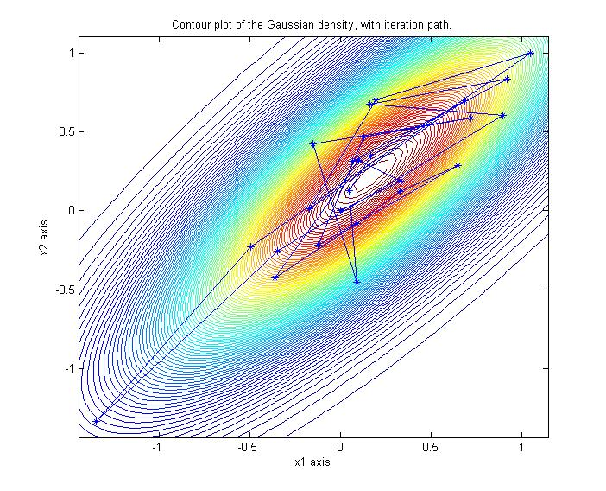
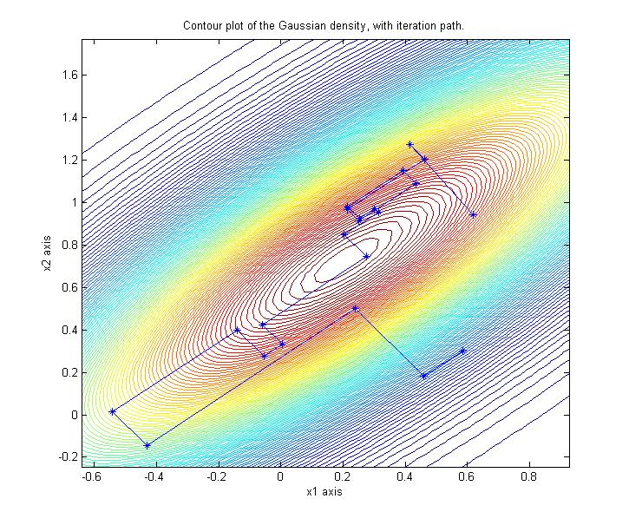
Correspondence between solvers and samplers of N(0, A⁻¹)
Solving Ax=b:
Gauss-Seidel Chebyshev-GS CG
Sampling y ~ N(0,A⁻¹):
Gibbs Chebyshev-Gibbs CG-Lanczos sampler
Notes:
Figure from Fox & P in prep

Slide 5
We consider iterative solvers of
Ax = b of the form:
1. Split the coefficient matrix A = M - N for M invertible.
2. x^{k+1} = (1- v_{k}) x^{k-1} + v_{k} x^{k} + v_{k} u_{k} M⁻¹ (b-A x^{k})
for some parameters v_{k} and u_{k}.
3. Check for convergence:
Quit if ||b - A x^{k+1} || is small.
Otherwise, update v_{k} and u_{k}, go to step 2.
Need to be able to inexpensively solve M u = r
Given M, it’s the same cost per iteration regardless of acceleration method used

Slide 6
For example …
x^{k+1} = (1- v_{k}) x^{k-1} + v_{k} x^{k} + v_{k} u_{k} M⁻¹ (b-A x^{k})
Gauss-Seidel
Chebyshev-GS
CG
M_{GS} = D + L,
v_{k} = u_{k} = 1
M = M_{GS} D M^{T}_{GS},
v_{k} and u_{k} are functions of the 2 extreme eigenvalues of
I - G=M⁻¹A
M = I,
v_{k} , u_{k} are functions of the residuals b - Ax^{k}

Slide 7
... and the solver error decreases according to a polynomial,
(x^{k} - A⁻¹b) = P_{k}(I-G)(x⁰ - A⁻¹b),
G=M⁻¹N I – G = M⁻¹A
Gauss-Seidel Chebyshev-GS
CG
P_{k}(I-G) = G^{k}
P_{k}(I-G)
is the k^{th} order Chebyshev polynomial
(the polynomial with smallest maximum between the two eigenvalues of I - G).
P_{k}(I-G)
is the k^{th} order Lanczos polynomial

Slide 8
... and the solver error decreases according to a polynomial,
(x^{k} - A⁻¹b) = P_{k}(I-G)(x⁰ - A⁻¹b),
G=M⁻¹N I – G = M⁻¹A
Gauss-Seidel Chebyshev-GS
CG
P_{k}(I-G) = G^{k},
stationary reduction factor is
P_{k}(I-G)
the k^{th} order Chebyshev polynomial,
asymptotic average reduction factor is optimal,
P_{k}(I-G)
is the k^{th} order Lanczos polynomial
p(G)
converges in a finite number of steps* depending on eig(I-G)
Notes:
So Gauss Siedel is stationary because the iteration operator is stationary, resulting in geometric convergence rate.
So the iteration converges as long as p(M⁻¹N) < 1.

Slide 9
Some common iterative linear solvers
Type |  | Splitting: M | convergence guaranteed* if:
Stationary (v_{k} = u_{k} = 1) | Richardson | 1/w I | 0 < w < 2/p(A)
 | Jacobi | D
 | Gauss- Seidel | D + L | always
 | SOR | 1/w D + L | 0 < w < 2
 | SSOR | w/(2-w) M_{SOR} D M^{T}_{SOR} | 0 < w < 2
Non-stationary | Chebyshev | Any symmetric splitting (e.g., SSOR or Richardson) where I-G is PD | stationary iteration converges
 | CG |  | always
Chebyshev is guaranteed to accelerate*
CG is guaranteed to accelerate *
Notes:
* Guaranteed in infinite precision

Slide 10
Your iterative linear solver for some new splitting:
Type |  | Splitting: M | convergence guaranteed* if:
Stationary | Your splitting | M = ? | p(G = M⁻¹N) < 1
Non-stationary | Chebyshev | Any symmetric splitting | stationary iteration converges
 | CG |  | always

Slide 11
For example:
Type |  | Splitting: M | convergence guaranteed* if:
Stationary | “subdiagonal” | 1/w D + L - D₋₁
Non-stationary | Chebyshev | Any symmetric splitting | stationary iteration converges
 | CG |  | always
Notes:
Sub diagonal, in Fox and Parker, in preparation.

Slide 12
Iterative linear solver performance in finite precision
Table from Fox & P, in prep.
Ax = b was solved for SPD 100 x 100 first order locally linear sparse matrix A.
Stopping criterion was ||b - A x^{k+1} ||₂ < 10⁻⁸.
Notes:
Convergence rate increases as we go down the table in roughly the same order as in previous tables.
Introduction of relaxation param different than 1 yields minor improvement in convergence.
Non-stationary methods yield vast improvement over stationary methods.
Shown p(M⁻¹N) for non-stat methods is really an asymptotic average converegnce factor

Slide 13
Iterative linear solver performance in finite precision
p(G)

Slide 14
What iterative samplers of N(0, A⁻¹) are available?
Solving Ax=b:
Gauss-Seidel Chebyshev-GS CG
Sampling y ~ N(0,A⁻¹):
Gibbs Chebyshev-Gibbs CG-Lanczos sampler

Slide 15
We study iterative samplers of
N(0, A⁻¹) of the form:
1. Split the precision matrix A = M - N for M invertible.
2. Sample c^{k} ~ N(0, (2-v_{k})/v_{k} ( (2 – u_{k})/ u_{k} M^{T} + N)
3. y^{k+1} = (1- v_{k}) y^{k-1} + v_{k} y^{k} + v_{k} u_{k} M⁻¹ (c^{k} -A y^{k}).
4. Check for convergence:
Quit if “the difference” between N(0, Var(y^{k+1})) and N(0, A⁻¹) is small.
Otherwise, update linear solver parameters v_{k} and u_{k}, go to step 2.
Need to be able to inexpensively solve M u = r
Need to be able to easily sample c^{k}
Given M, it’s the same cost per iteration regardless of acceleration method used

Slide 16
For example …
y^{k+1} = (1- v_{k}) y^{k-1} + v_{k} y^{k} + v_{k} u_{k} M⁻¹ (c^{k} -A y^{k})
c^{k} ~ N(0, (2-v_{k})/v_{k} ( (2 – u_{k})/ u_{k} M^{T} + N)
Gibbs Chebyshev-Gibbs CG-Lanczos
M_{GS} = D + L,
v_{k} = u_{k} = 1
M = M_{GS} D M^{T}_{GS},
v_{k} and u_{k} are functions of the 2 extreme eigenvalues of
I-G=M⁻¹A
M = I,
v_{k} , u_{k} are functions of the residuals b - Ax^{k}

Slide 17
... and the sampler error decreases according to a polynomial,
(E(y^{k}) - 0)= P_{k}(I-G) (E(y⁰) – 0)
(A⁻¹ - Var(y^{k})) = P_{k}(I-G) (A⁻¹ - Var(y⁰)) P_{k}(I-G)^{T}
(A⁻¹ - Var(y^{k}))v = 0
for any Krylov vector v
Gibbs Chebyshev-Gibbs
CG-Lanczos
P_{k}(I-G)
k^{th} order Chebyshev polyomial,
optimal asymptotic average reduction factor is
P_{k}(I-G) = G^{k},
with error reduction factor
Var(y^{k}) is the k^{th} order
CG polynomial
converges in a finite number of steps* in a Krylov space
depending on eig(I-G)
p(G)²
Notes:
Stat. sampler and Cheby results: Fox and P 2012; CG results: Parker and F 2012.

Slide 18
My attempt at the historical development of iterative Gaussian samplers:
Type |  | Sampler | Literature
Stationary (v_{k} = u_{k} = 1) | Matrix Splittings | Gibbs (Gauss-Seidel) | Adler 1981, Goodman & Sokal 1989, Amit & Grenander 1991
 |  | BF (SOR) | Barone & Frigessi 1990
 |  | REGS (SSOR) | Roberts & Sahu 1997
 |  | Generalized | Fox & P 2013
 | Multi-Grid |  | Goodman & Sokal 1989 Liu & Sabatti 2000
Non-stationary | Krylov sampling with conjugate directions | Lanczos Krylov subspace | Schneider & Wilsky 2003
 |  | CD Sampler | Fox 2007
 |  | Heat Baths with CG, CG Sampler | Ceriotti, Bussi & Parrinello 2007 P & Fox 2012
 | Krylov sampling with Lanczos vectors | Lanczos sampler | Simpson, Turner, & Pettitt 2008
 | Chebyshev |  | Fox & P 2013

Slide 19
More details for some iterative Gaussian samplers
Type |  | Splitting: M | Var(c^{k}) = M^{T} + N | convergence guaranteed* if:
Stationary (v_{k} = u_{k} = 1) | Richardson | 1/w I | 2/w I - A | 0 < w < 2/p(A)
 | Jacobi | D | 2D - A
 | GS/Gibbs | D + L | D | always
 | SOR/BF | 1/w D + L | (2-w)/w D | 0 < w < 2
 | SSOR/REGS | w/(2-w) M_{SOR} D M^{T}_{SOR} | w/(2 - w) (M_{SOR}D⁻¹ M^{T}_{SOR} + N_{SOR} D⁻¹ N^{T}_{SOR}) | 0 < w < 2
Non-stationary | Chebyshev | Any symmetric splitting (e.g., SSOR or Richardson) | (2-v_{k})/v_{k} ( (2 – u_{k})/ u_{k} M + N | stationary iteration converges
 | CG |  | -- | always*
Notes:
Guaranteed in infinite precision.
Increase in speed as you go down the rows.

Slide 20
Sampler speed increases because solver speed increases
Notes:
Equivalence in convergence factors implies that convergence rates follow the same increase as we move down the rows as the linear solvers did.
Linear solver convergence rates guarantees that these non-stat methods have same increase in convergence rates
i.e. Cheby is faster than stat. sampler, CG sampler converges in finite number of iterations

Slide 21
Theorem
An iterative Gaussian sampler converges
(to N(0, A⁻¹)) faster # than the corresponding linear solver as long as v_{k} , u_{k} are independent of the iterates y^{k} (Fox & P 2013).
Gibbs Sampler Chebyshev Accelerated Gibbs

Slide 22
Theorem
An iterative Gaussian sampler converges
(to N(0, A⁻¹)) faster# than the corresponding linear solver as long as v_{k} , u_{k} are independent of the iterates y^{k} (Fox & P 2013).
# The sampler variance error reduction factor is the square of the reduction factor for the solver:
So:
The Theorem does not apply to Krylov samplers.
Samplers can use the same stopping criteria as solvers.
If a solver converges in n iterations, so does the sampler
Stationary sampler: p(G)²
Notes:
* In finite precision

Slide 23
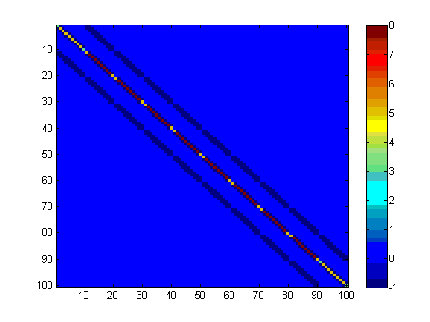
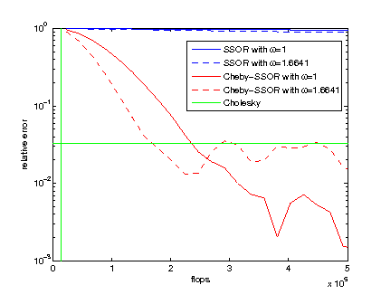
In theory and finite precision,
Chebyshev acceleration is faster than a Gibbs sampler
Example: N(0, ⁻¹ ) in 100D
Covariance matrix convergence,
||A⁻¹ – Var(y^{k})||₂ /||A⁻¹ ||₂
Benchmark for cost in finite precision is the cost of a Cholesky factorization
Benchmark for
convergence in
finite precision is
10⁵ Cholesky samples
Notes:
2D Laplacian in 100 dimensions

Slide 24
Sampler stopping criterion

Slide 25
Algorithm for an iterative sampler of
N(0, A⁻¹) with a vague stopping criterion:
1. Split A = M - N for M invertible.
2. Sample c^{k} ~ N(0, (2-v_{k})/v_{k} ( (2 – u_{k})/ u_{k} M^{T} + N)
3. y^{k+1} = (1- v_{k}) y^{k-1} + v_{k} y^{k} + v_{k} u_{k} M⁻¹ (c^{k} -A y^{k}).
4. Check for convergence:
Quit if “the difference” between N(0, Var(y^{k+1})) and N(0, A⁻¹) is small.
Otherwise, update linear solver parameters v_{k} and u_{k}, go to step 2.

Slide 26
Algorithm for an iterative sampler of
N(0, A⁻¹) with an explicit stopping criterion:
1. Split A = M - N for M invertible.
2. Sample c^{k} ~ N(0, (2-v_{k})/v_{k} ( (2 – u_{k})/ u_{k} M + N)
3. x^{k+1} = (1- v_{k}) x^{k-1} + v_{k} x^{k} + v_{k} u_{k} M⁻¹ (b-Ax^{k})
4. y^{k+1} = (1- v_{k}) y^{k-1} + v_{k} y^{k} + v_{k} u_{k} M⁻¹ (c^{k} -Ay^{k})
5. Check for convergence:
Quit if ||b - A x^{k+1} || is small.
Otherwise, update linear solver parameters v_{k} and u_{k}, go to step 2.
Notes:
Doubling cost!

Slide 27
An example: a Gibbs sampler of N(0, A⁻¹) with a stopping criterion:
1. Split A = M - N where M = D + L
2. Sample c^{k} ~ N(0, M^{T} + N)
3. x^{k+1} = x^{k} + M⁻¹ (b - A x^{k}) <------ Gauss-Seidel iteration
4. y^{k+1} = y^{k} + M⁻¹ (c^{k} -A y^{k}) <------ (bog standard) Gibbs iteration
5. Check for convergence:
Quit if ||b - A x^{k+1} || is small.
Otherwise, go to step 2.

Slide 28
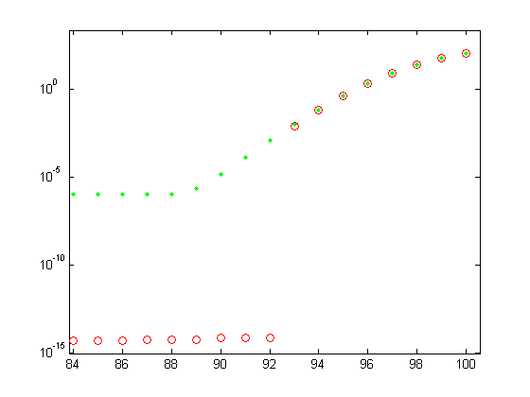
Stopping criterion for the CG sampler
The CG sampler also uses ||b - A x^{k+1} || as a stopping criterion, but a small residual merely indicates that the sampler has successfully sampled (i.e., ‘converged’)
in a Krylov subspace
(this same issue occurs with CG-Lanczos solvers).
Only 8 eigenvectors
(corresponding to the 8 largest eigenvalues of A⁻¹)
are sampled
by the CG sampler

Slide 29
Stopping criteria for the CG sampler
The CG sampler also uses ||b - A x^{k+1} || as a stopping criterion, but a small residual merely indicates that the sampler has successfully sampled (i.e., ‘converged’)
in a Krylov subspace
(this same issue occurs with CG-Lanczos solvers).
A coarse assessment of the accuracy of the distribution of the CG sample is to estimate (P & Fox 2012):
trace(Var(y^{k}))/trace(A⁻¹ ).
The denominator trace(A⁻¹ ) is estimated by the CG sampler using a sweet-as (minimum variance) Lanczos Monte Carlo scheme (Bai, Fahey, & Golub 1996).
Notes:
Z. Bai, M. Fahey, and G. H. Golub, Some large-scale matrix computation problems, J.
Comput. Appl. Math., 74 (1996), pp. 71–89.

Slide 30
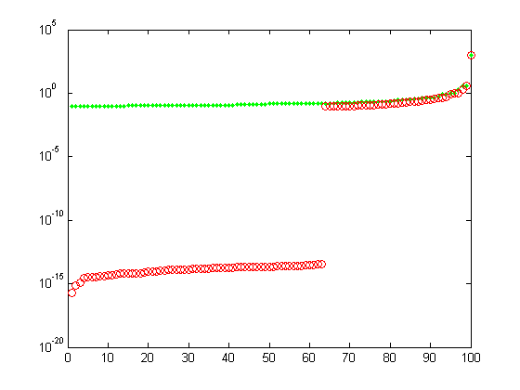
Example: 10² Laplacian over a 10x10 2D domain
eigenvalues of A⁻¹
37 eigenvectors
are sampled
(and estimated)
by the CG sampler.
A=
Notes:
Table from P & F 2012 – sampler stopped when L2 norm of residual < 1e-4 for 10^5 sampler runs.

Slide 31
How many sampler iterations until convergence?

Slide 32
A priori calculation of the number of
solver iterations to convergence
Since the solver error decreases according to a polynomial,
(x^{k} - A⁻¹b) = P_{k}(I-G)(x⁰ - A⁻¹b), G=M⁻¹N
then the estimated number of iterations k until the error reduction ||x^{k} - A⁻¹b|| / ||x⁰ - A⁻¹b < ε is about (Axelsson 1996):
Stationary splitting:
k = lnε/ ln(p(G))
Chebyshev:
k = ln(ε/2)/lnσ
Gauss-Seidel Chebyshev-GS
P_{k}(I-G) = G^{k}
P_{k}(I-G)
is the k^{th} order Chebyshev polynomial

Slide 33
A priori calculation of the number of
sampler iterations to convergence
... and since the sampler error decreases according to the
same polynomial
(E(y^{k}) – 0)= P_{k}(I-G)(E(y⁰) – 0)
(A⁻¹ - Var(y^{k})) = P_{k}(I-G) (A⁻¹ - Var(y⁰)) P_{k}(I-G)^{T}
Gibbs Chebyshev-Gibbs
P_{k}(I-G) = G^{k}
P_{k}(I-G)
is the k^{th} order Chebyshev polynomial

Slide 34
A priori calculation of the number of
sampler iterations to convergence
... and since the sampler error decreases according to the
same polynomial
(E(y^{k}) – 0)= P_{k}(I-G)(E(y⁰) – 0)
(A⁻¹ - Var(y^{k})) = P_{k}(I-G) (A⁻¹ - Var(y⁰)) P_{k}(I-G)^{T}
THEN (Fox & Parker 2013) the suggested number of iterations k until the
error reduction
||Var(y^{k} ) - A⁻¹|| / ||Var(y⁰ ) - A⁻¹|| < ε
is about:
Stationary splitting: k = lnε/ ln(p(G)²)
Chebyshev: k = ln(ε/2)/ln(σ²),

Slide 35
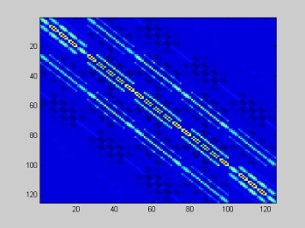
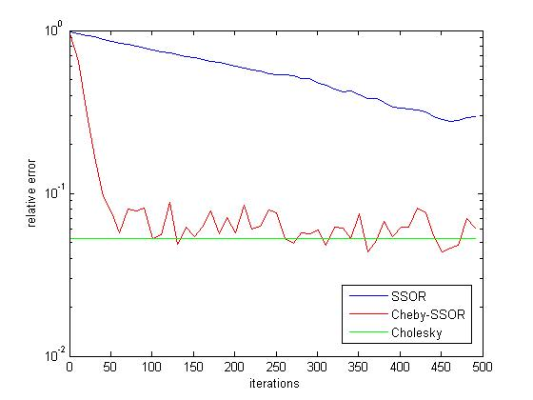
A priori calculation of the number of
sampler iterations to convergence
For example: Sampling from N(0, ⁻¹)
Predicted vs. Actual
number of iterations k until the error reduction in variance
is less than ε = 10⁻⁸:
 |  | Predicted | Actual
Solvers | SSOR | 14161 | 13441
 | Chebyshev-SSOR | 269 | 296
Samplers | SSOR | 7076 | --
 | Chebyshev-SSOR | 135 | 60*
p(G) = 0.9987, σ = 0.9312,
Finite precision benchmark is the
Cholesky relative error = 0.0525
Notes:
P & Fox 2013, precision formed by FEM method, square of the Helmholtz operator.
* = Variance error hovers around Cholesky error, never really gets to 10^(-8)!!!!

Slide 36
“Equivalent” sampler implementations yield different results in finite precision

Slide 37
Different Lanczos sampling results due to different
finite precision implementations
It is well known that “equivalent”
CG and Lanczos algorithms (in exact arithmetic) perform
very differently in finite precision.
Iterative Krylov samplers
(i.e., with Lanczos-CD, CD, CG, or Lanczos-vectors) are equivalent in exact arithmetic, but implementations in finite precision can yield different results. This is currently under numerical investigation.

Slide 38
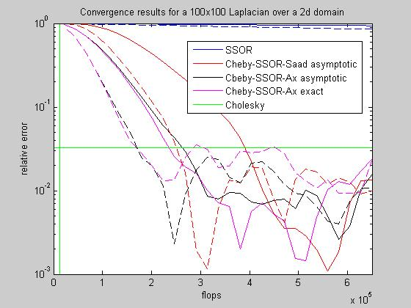
Different Chebyshev sampling results due to different
finite precision implementations
There are at least three implementations of modern (i.e., second-order) Chebyshev accelerated linear solvers
(e.g., Axelsson 1991, Saad 2003, and Golub & Van Loan 1996).
Some preliminary results comparing Axelsson and Saad implementations:

Slide 39
A fast iterative sampler
(i.e., PCG-Chebyshev-SSOR) of N(0, A⁻¹)
(given a precision matrix A)

Slide 40
A fast iterative sampler for LARGE N(0, A⁻¹):
Use a combination of samplers:
Use a PCG sampler
(with splitting/preconditioner M_{SSOR})
to generate a sample y^{k}_{PCG} approx. dist. as N(0, M_{SSOR}^{1/2} A⁻¹ M_{SSOR}^{1/2} ) and estimates of the extreme eigenvalues of I – G = M_{SSOR}⁻¹ A.
Seed the samples M_{SSOR}^{-1/2} y^{k}_{PCG} and the extreme eigenvalues into a Chebyshev accelerated SSOR sampler.
A similar to approach has been used running Chebyshev-accelerated solvers with multiple RHSs (Golub, Ruiz & Touhami 2007).
Notes:
G. H. Golub, D. Ruiz, and A. Touhami, A hybrid approach combining Chebyshev filter
and conjugate gradient for solving linear systems with multiple right-hand sides, SIAM J.
Matrix Anal. Appl., 29 (2007), pp. 774–795.

Slide 41
Example sampling via Chebyshev-SSOR sampling
from N(0, ⁻¹ ) in 100D
Covariance matrix convergence,
||A⁻¹ – Var(y^{k})||₂ /||A⁻¹ ||₂
Notes:
2D Laplacian in 100 dimensions
Left off CG in title because here I used MATLAB’s eig( ) to calculate the eigenvalues.

Slide 42
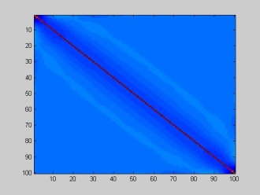
Comparing CG-Chebyshev-SSOR to Chebyshev-SSOR sampling from N(0, ):
 | w | ||A⁻¹ – Var(y¹⁰⁰)||₂/||A⁻¹ ||₂
Gibbs (GS) | 1 | 0.992
SSOR | 0.2122 | 0.973
Chebyshev-SSOR | 1 | 0.805
 | 0.2122 | 0.316
CG-Chebyshev-SSOR | 1 | 0.757
 | 0.2122 | 0.317
Cholesky | -- | 0.199
Numerical examples suggest that seeding Chebyshev with a CG sample AND CG-estimated eigenvalues do at least as good a job as when using a “direct” eigen-solver (such as the QR-algorithm implemented via MATLAB’s eig( )).
Notes:
After 100 iterations, A = Gaussian Covariance ….
Results from GSv3.pdf, Table 3!
A= GetCov(linspace(-3,2,100),[2 0 .001],1.5,1); % Gaussian covariance
norm(inv(A)) = 1e3.

Slide 43
Convergence to N(0, A⁻¹) implies convergence to N(0,A).
The converse is not necessarily true.

Slide 44
Can N(0, A⁻¹) be used to sample from N(0,A)?
If you have an “exact” sample y ~ N(0, A⁻¹), then simply multiplying by A yields a sample b = Ay ~ y ~ N(0, AA⁻¹A) = N(0, A).
This result holds as long as you know how to multiply by A.
Theoretical support:
  For a sample y^{k} produced by the non-Krylov iterative samplers presented, the error in covariance of Ay^{k} is:
  A - Var(Ay^{k}) = AP_{k}(I-G) (A - Var(Ay⁰)) P_{k}(I-G)^{T} A
  = P_{k}(I-G^{T}) (A - Var(Ay⁰)) P_{k}(I-G^{T}) ^{T}
  Therefore, the asymptotic reduction factors of the stationary and Chebyshev samples of either y^{k} or Ay^{k} are the same (i.e., p(G)² and
resp.).
Unfortunately, whereas the reduction factor σ² for Chebyshev sampling
y^{k} ~ N(0, A⁻¹) is optimal, σ² is (likely) less than optimal for Ay^{k} ~ N(0, A).

Slide 45
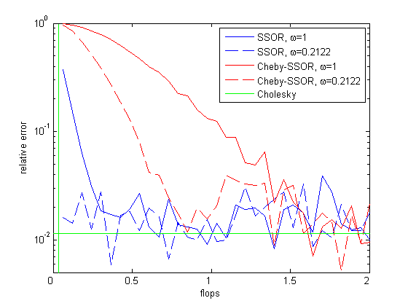
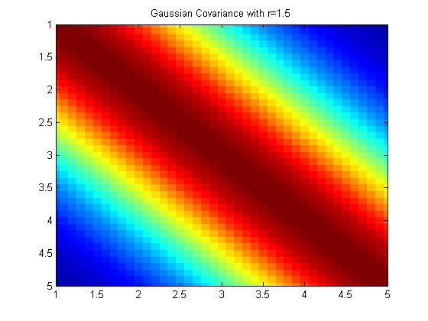
Example of convergence using samples
y^{k}~N(0, A⁻¹) to generate samples
Ay^{k} ~ N(0, A)
A =
Notes:
F & P in prep

Slide 46
How about using N(0,A) to sample from N(0,A⁻¹)?
You may have an “exact” sample
b ~ N(0, A) and yet you want y ~ N(0, A⁻¹) (e.g., when studying spatiotemporal
patterns in tropical surface winds in Wikle et al. 2001).
Given b ~ N(0, A), then simply multiplying by A⁻¹ yields a sample
y = A⁻¹b ~ N(0, A⁻¹AA⁻¹) = N(0, A⁻¹).
This result holds as long as you know how to multiply by A⁻¹.
Unfortunately, it is often the case that multiplication by A⁻¹ can only be performed approximately (e.g., using CG (Wikle et al. 2001)).
When using the CG solver to generate a sample y^{k}_{CG} ~= A⁻¹ b when b ~ N(0,A), y^{k}_{CG} approx. A⁻¹ b gets ``stuck” in a k-dimensional Krylov subspace and only has the correct N(0, A⁻¹) distribution if the k-dimensional Krylov space well approximates the eigenspaces corresponding to the large eigenvalues of of A⁻¹ (P & Fox 2012).
Point: For large problems where direct methods are not available, use a Chebyshev accelerated solver to solve Ay = b to generate y ~ N(0, A⁻¹) from b ~ N(0,A)!
Notes:
C. K. Wikle, R. F. Milliff, D. Nychka, and M. Berliner, Spatiotemporal hierarchical
Bayesian modeling: Tropical ocean surface winds, J. Amer. Statist. Assoc., 96 (2001),
pp. 382–397.

Slide 47
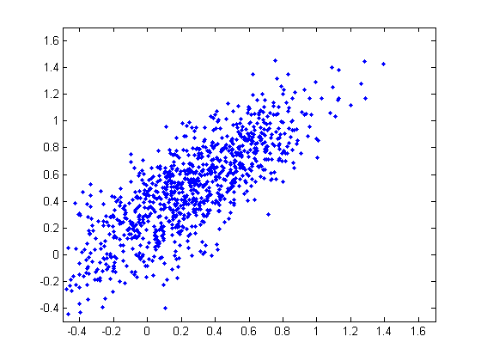
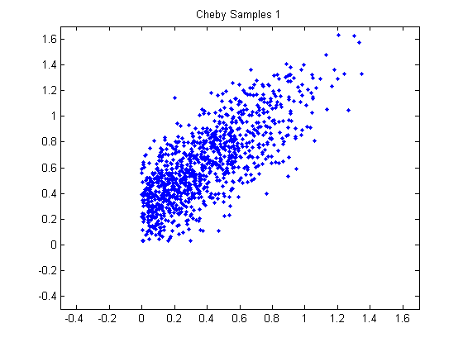
Some Future Work
Meld a Krylov sampler (fast but “stuck” in a Krylov space in finite precision) with Chebyshev acceleration (slower but with guaranteed convergence).
Prove convergence of the Chebyshev accelerated sampler under
positivity constraints.
Apply some of these ideas to confocal microscope image analysis and nuclear magnetic resonance experimental design biofilm problems.

