Slide 1

Wind energy in NZ
20% wind by 2030
Eric Pyle, Chief Executive, NZ Wind Energy Association

Slide 2
About NZWEA
Represents around 65 companies:
    Generators and developers
    Transpower and lines companies
    Turbine manufacturers, equipment suppliers
    Consultancies, financiers and legal firms.
Policy & regulatory advocacy, public awareness and industry development.
Utility scale generation only

Slide 3
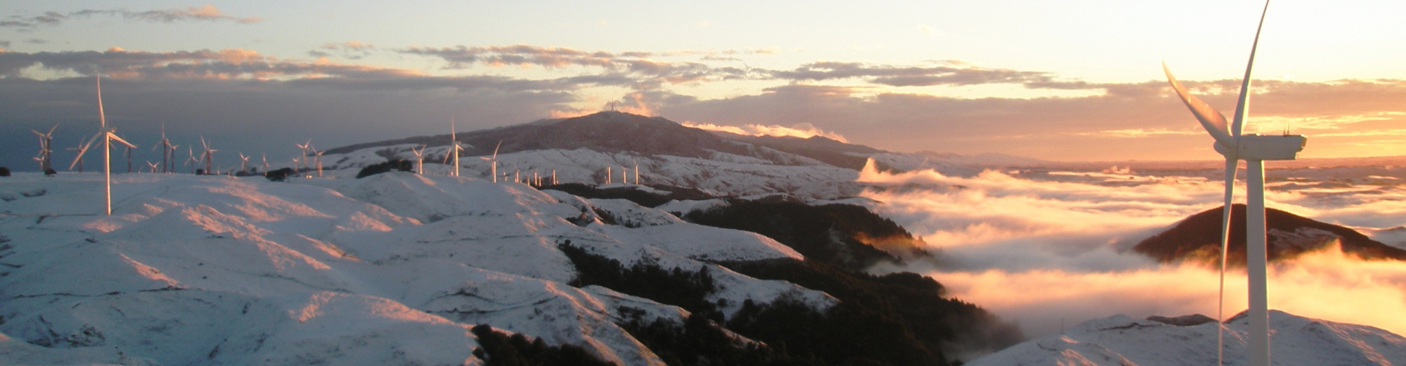
Agenda
Wind – past and present
Vision for 2030
Challenges on route

Slide 4
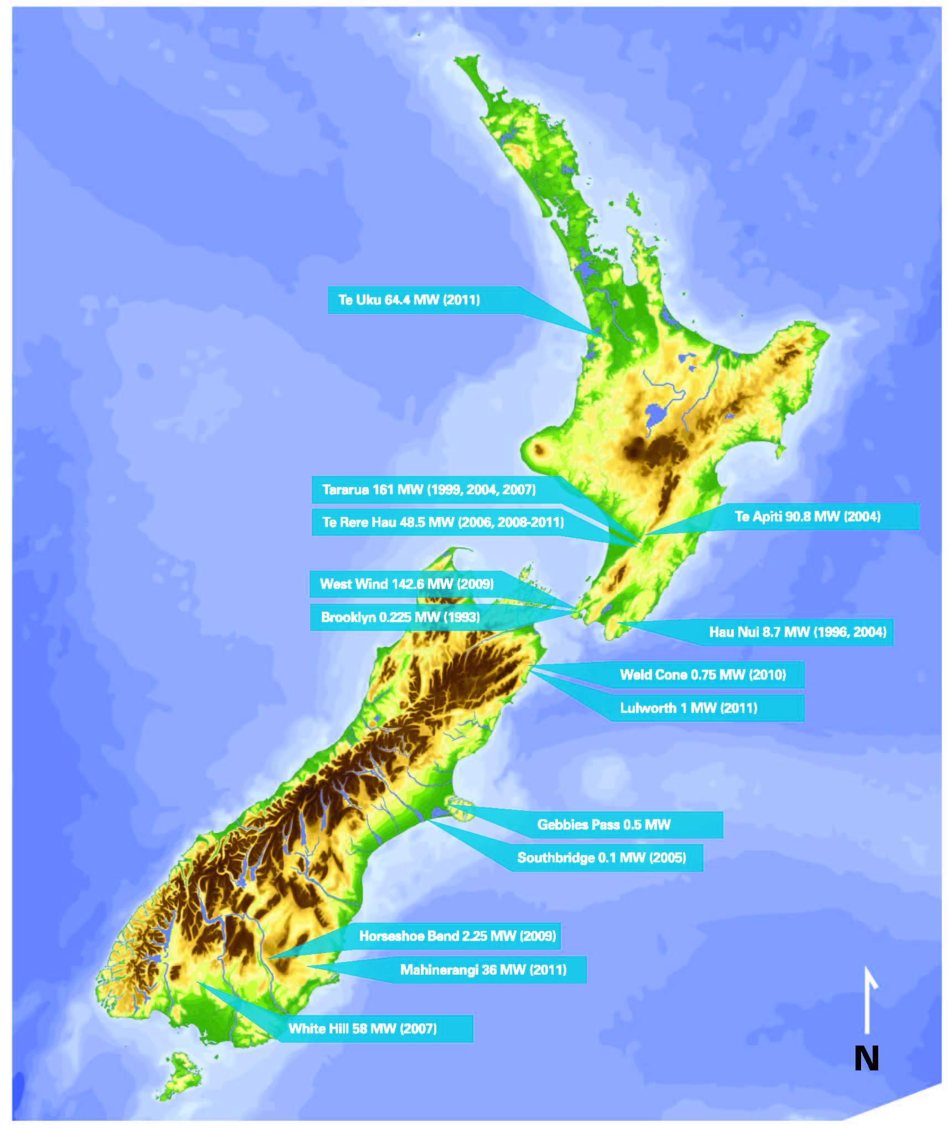
Wind generation - today
17 wind farms
623 MW generating capacity
60 MW under construction
4.5% of NZ’s annual generation
1600MW + consented

Slide 5
Who is involved?
All five major generators
Independent developers
International technology and equipment providers – turbines, electrical components, cables …
Service providers – planning, legal, engineering, environmental, operations and maintenance, health and safety…
Employment - 2011 | Direct FTE | Total FTE
Wind | 380 | 649
Oil and gas extraction | 592

Slide 6
Wind capacity – 2001 to present

Slide 7
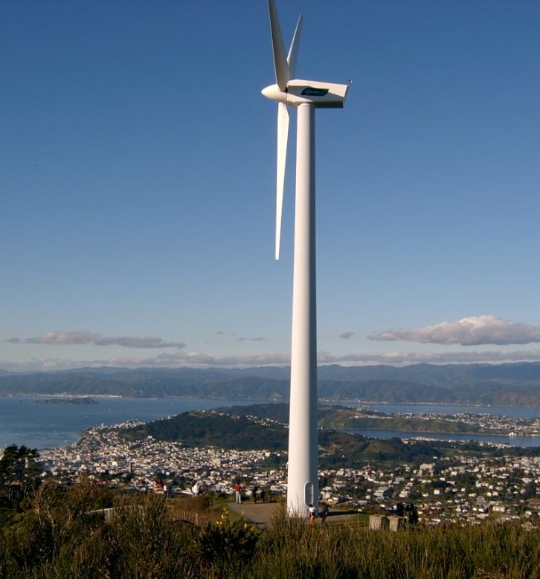
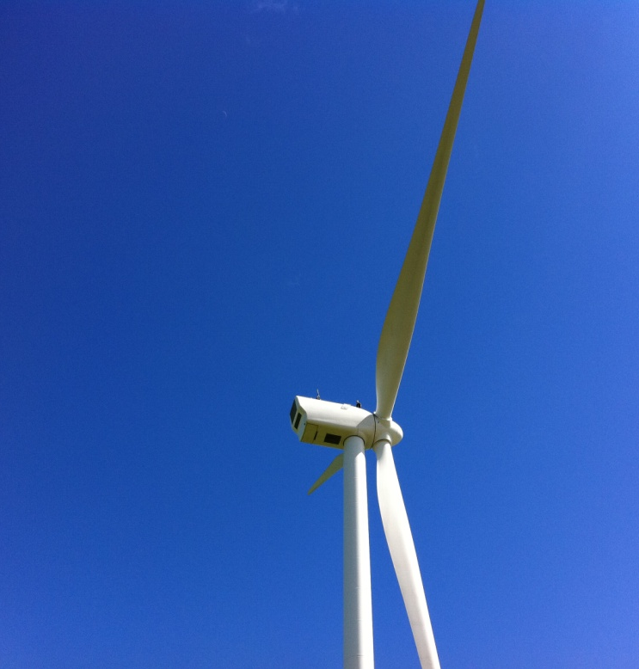
A long way in a short time…
13 fold increase in capacity in 14 years
4 to 6 fold reduction in costs
1993: 0.225MW
$13m/MW
2007: 3MW
$2-3m/MW

Slide 8
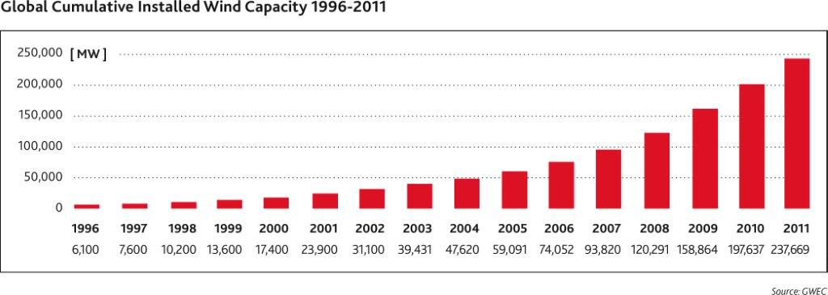
Rapid international growth
The NZ difference
No government subsidies or support mechanisms
Wind farms built only when investors are confident that they can generate electricity at a cost that is competitive in today’s market

Slide 9
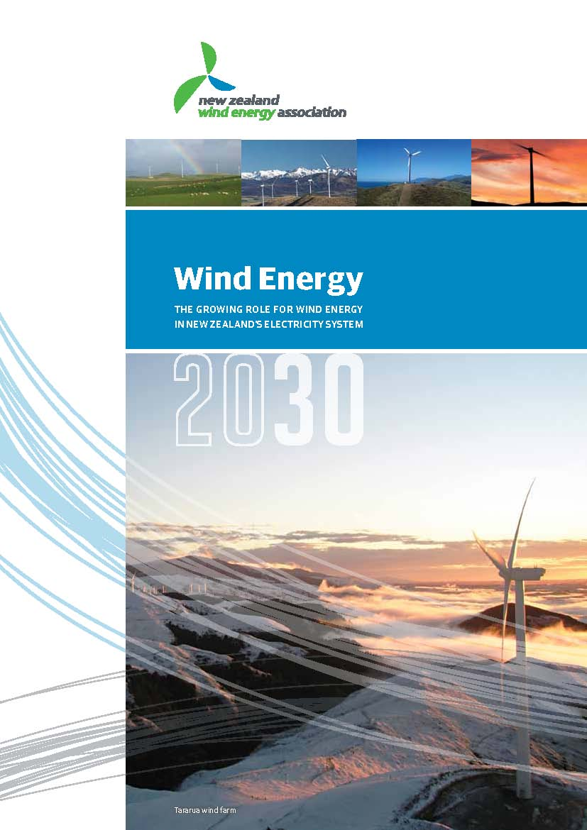
Vision: Wind energy 20% by 2030
622MW now to
3500MW in 2030
Requires investment of $300m per year
20% wind energy
Is achievable – NZ has excellent sites
Fits with the existing electricity system
Accepts the constraints of our
available resources
Will deliver economic benefits

Slide 10
The electricity system in 2030
43,000GWh in 2010 to 53,000 GWh
7GW peak to 8GW
Generation Capacity (GW) | 2012 | 2030
Hydro | 5.2 | 5.4
Geothermal | 0.7 | 1.2
Wind | 0.6 | 3.4
Gas | 1.4 | 2.3
Coal | 1.0 | 0.25
Other | ? | ?

Slide 11
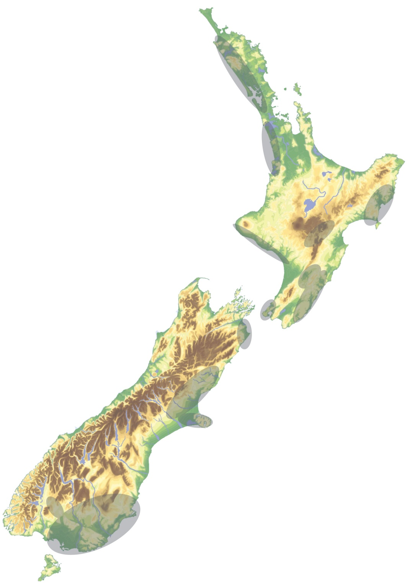
Wind generation – where next?
Notes:
More community scheme

Slide 12
Economic benefits
Employment (FTE) | Direct | Total
2011 | 380 | 649
2031 | 764 | 1430
GDP contribution ($m) | Direct | Total
2011 | 36 | 65
2031 | 81m | 156
Notes:
Employment more than doubles from 649 FTEs to 1,400 FTEs
GDP increases from $65 million to $156 million
Similar in size to:
oil and gas extraction (592 FTEs)
gas supply (540 FTEs)
metal ore mining ($84 million)
aquaculture ($93 million).

Slide 13
Economic benefits
Development of new products and services
Skill development
Exports
Tourism and recreation
Regional economic development
Security of supply

Slide 14
In 2030 NZWEA expects
At least 20% of NZ electricity to come from wind
Diverse range of investors and developers
Wind savvy RMA plans
NZ wind specialist companies operating internationally
Wind R&D programme created in partnership between government and the private sector
A safe, forward-looking industry that provides good returns for investors
Notes:
Increase in independents

Slide 15
Challenges on the path to 2030
Expensive?

Slide 16
Competing directly with alternative technologies

Slide 17
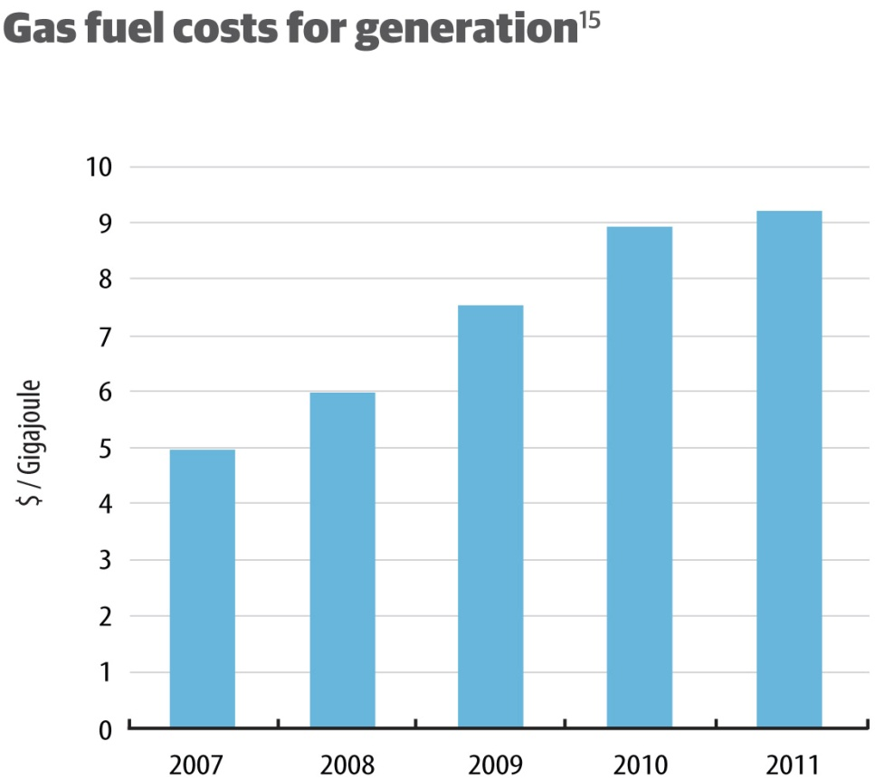
Cost effective
At $9GJ the best wind sites are cheaper than gas generation

Slide 18
Reducing cost of energy
Drivetrain - reduced cost and increased reliability
Efficiencies in manufacturing
Improvement in O&M, increased availability
Improved resource assessment
Larger rotors and taller towers – increased energy capture
The past and future cost of wind energy, IEA Wind, 2012

Slide 19
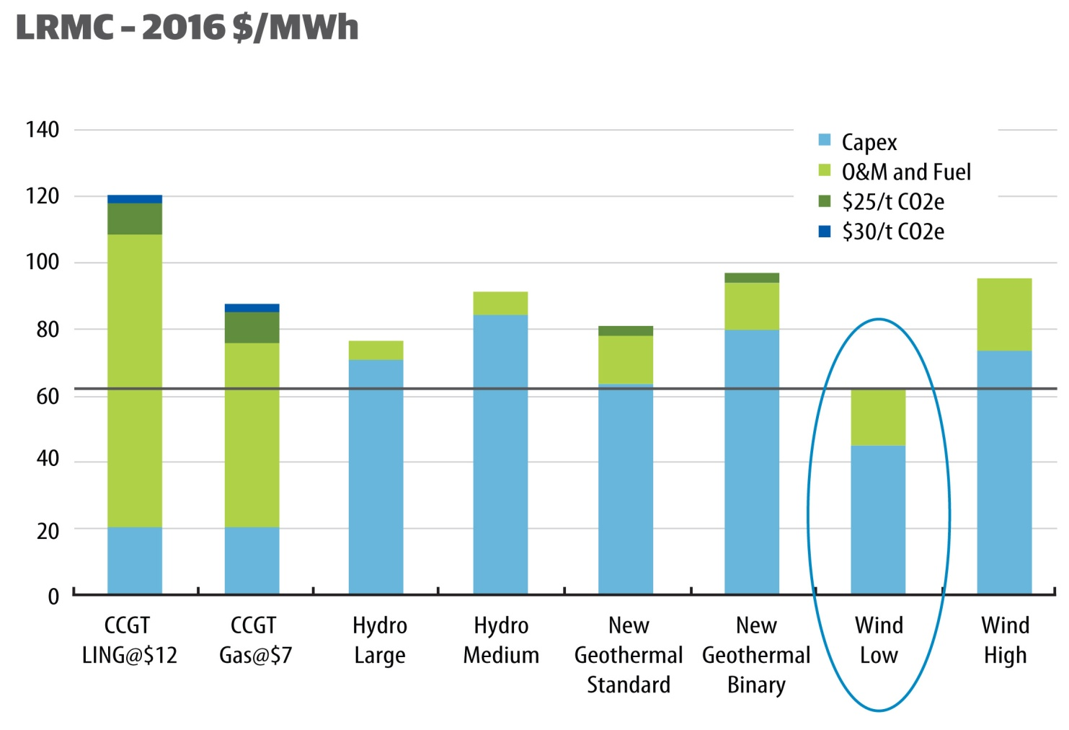
Reducing costs
Low-cost option for new electricity generation
Notes:
Discuss demand,
Change out of higher priced generation
Niche generation

Slide 20
Cost of energy drivers
Project Life
Cost of Capital
Capital Cost
Project Cost
Transmission
Total
Annual Cost
Site optimisation, micro-siting,
O&M Cost
Cost of Energy
Turbine
Design
Energy
Produced
Wind Speed and
Characteristics
Notes:
Click through the major cost drivers
Talk to arrows which show how a number of the components are connected
Make specific comments on the value engineering approach that is applied which ultimately drives down the cost of the project

Slide 21
Challenges on the path to 2030
Expensive
Unreliable?

Slide 22
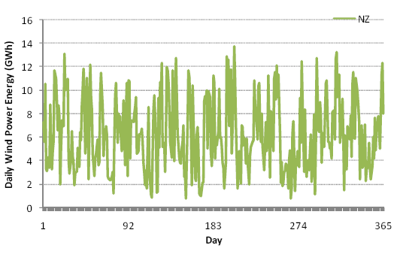
The wind always blows …
No days with zero wind generation
(from Strbac study on NZ)

Slide 23
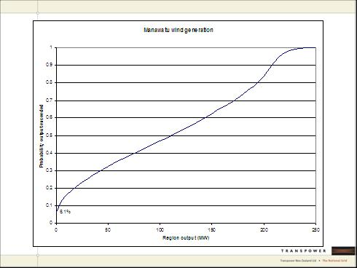
And blows …
Output duration curve for the Manawatu wind farms

Slide 24
And blows…
Output correlation:
Manawatu wind farms
Manawatu and Southland wind farms
Electricity Commission, ‘Wind Integration Project – Project Plan’, 8 September 2008

Slide 25
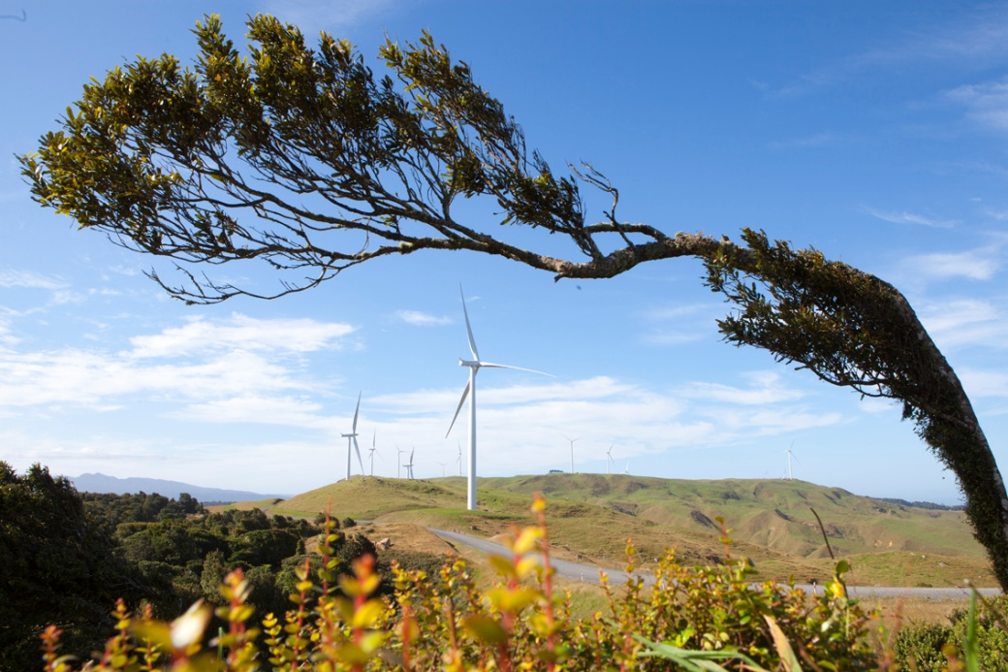
Variable, but still reliable
Seasonally reliable
Predictable
Known fuel cost
Synergy with hydro
Forecasting key
to integration

Slide 26
Challenges on the path to 2030
Expensive
Unreliable
Difficult to integrate into electricity networks

Slide 27
A challenge, but…
“Grid operators worldwide are increasingly positive about integrating wind generation as they share best practices and learn about the success of their peers.”
Strategies and Decision support systems for integrating variable energy resources in control centers for reliable grid operations, US Dept. of Energy, 2011
Keys for successful wind integration:
Forecasting, decision support tools,
policy and regulation, flexibility

Slide 28
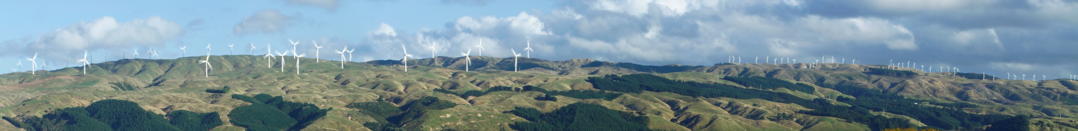
Helping to stabilise the network
Reactive power
Frequency keeping and voltage support
Fault ride through

Slide 29
Challenges on the path to 2030
Expensive
Unreliable
Difficult to integrate into electricity networks
Nobody wants it in their backyard

Slide 30
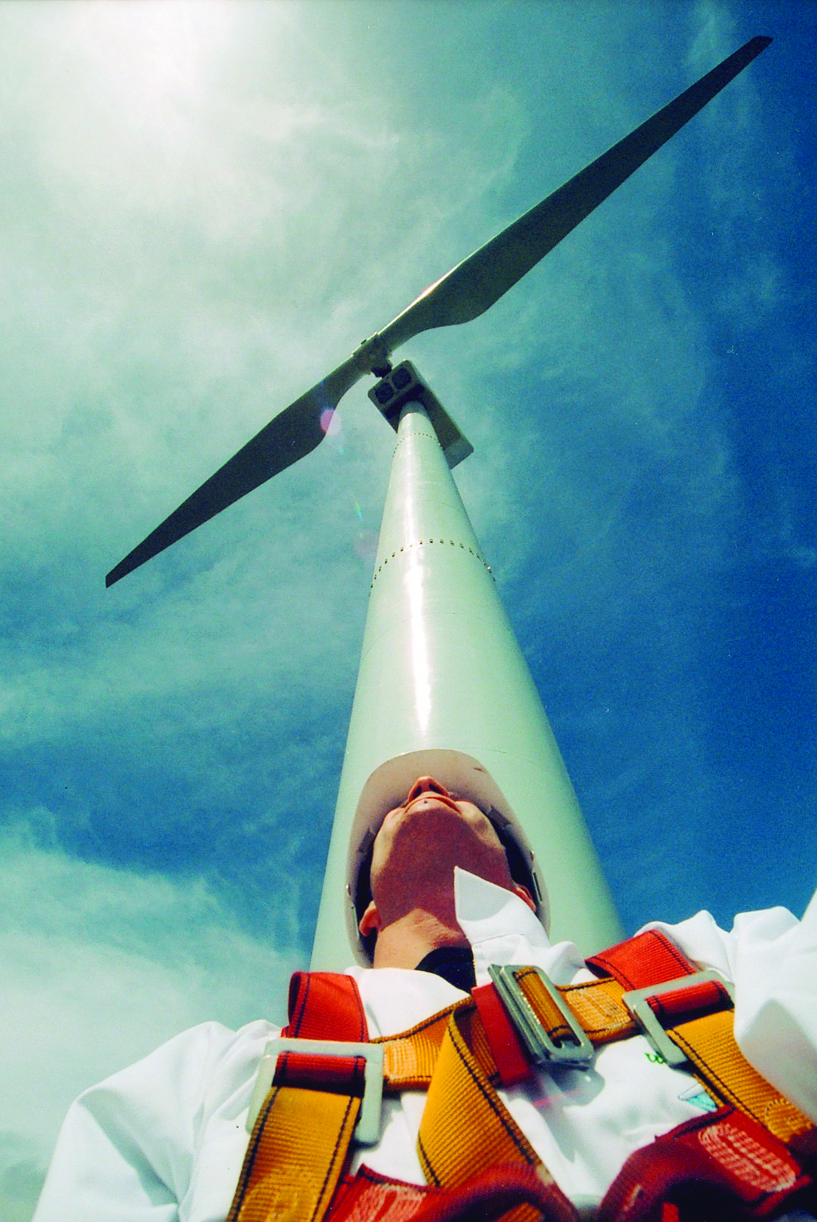
New Zealanders like wind
76% of NZers support wind
(EECA survey 2011)
Increasing number of community wind initiatives
Challenge is for developers and operators to be good neighbours

Slide 31
NZWEA’s focus
Understanding by public, Government, Councils
Challenging the out-dated perception of wind as unreliable and expensive
Improving recognition of the economic benefits
Consenting
  Improving speed and consistency
Integration of wind farms
  Grid - needs to cater for future generation
  More sophisticated electricity market
Developing an industry
  Health and safety
  Servicing and training
  Supply chains

Slide 32
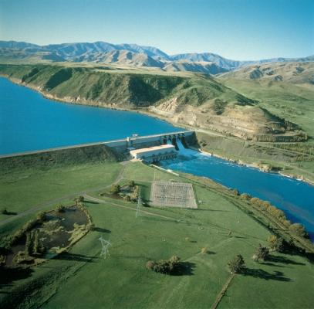
A final thought: the stages of electricity generation in NZ
1900–80s: Hydro

Slide 33
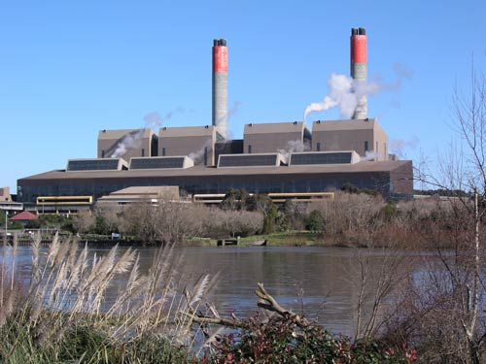
A final thought: the stages of electricity generation in NZ
1900–80s: Hydro
1970s–2000s:
Thermal

Slide 34
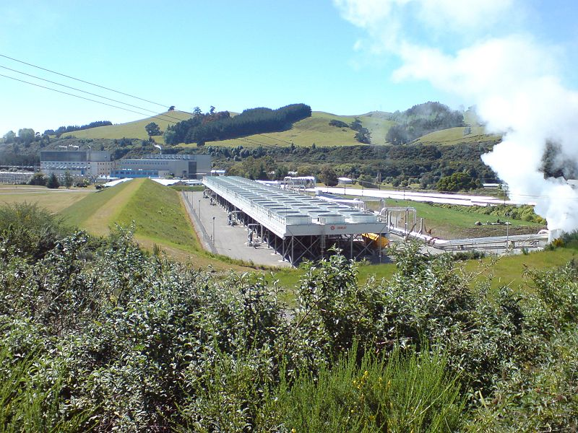
A final thought: the stages of electricity generation in NZ
1900–80s: Hydro
1970s–2000s:
Thermal
1990s–2020:
Geothermal

Slide 35
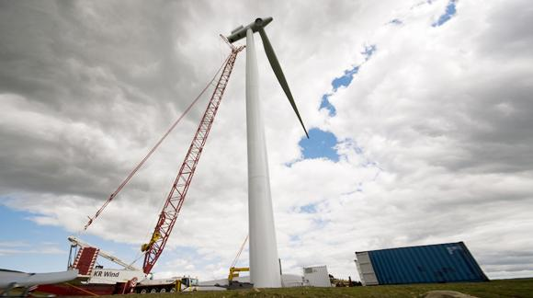
A final thought: the stages of electricity generation in NZ
1900–80s: Hydro
1970s–2000s:
Thermal
1990s–2020:
Geothermal
2000s–2030:
Wind

Slide 36
Questions?
Want to know more about wind energy?
Become a member of NZWEA
Wind Connections Workshop
Day1: Connecting wind farms to networks and the grid
Day 2: Wind energy in the electricity market of the future
24-25 October, Wellington
2013 NZ Wind Energy Conference
and Exhibition
25-27 March, Wellington

